Slide 1
Gihan Shamike Liyanage

Slide 2
Yes Yes/No
Yes Yes/No

Slide 3
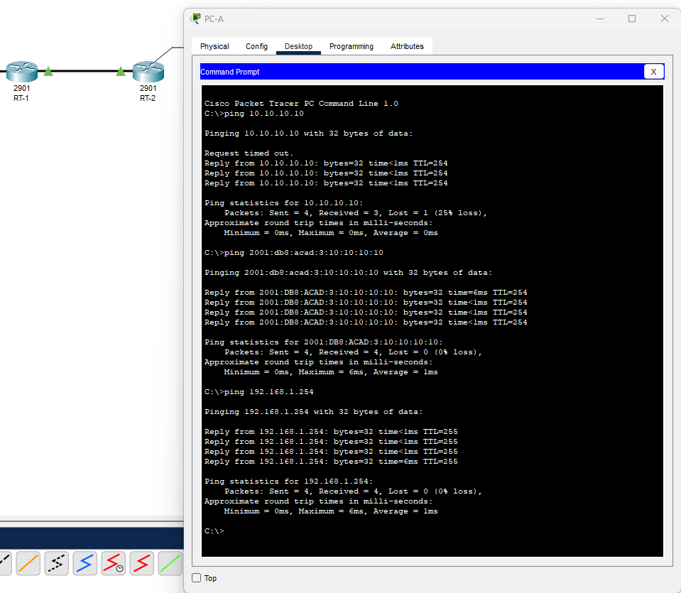

Slide 4
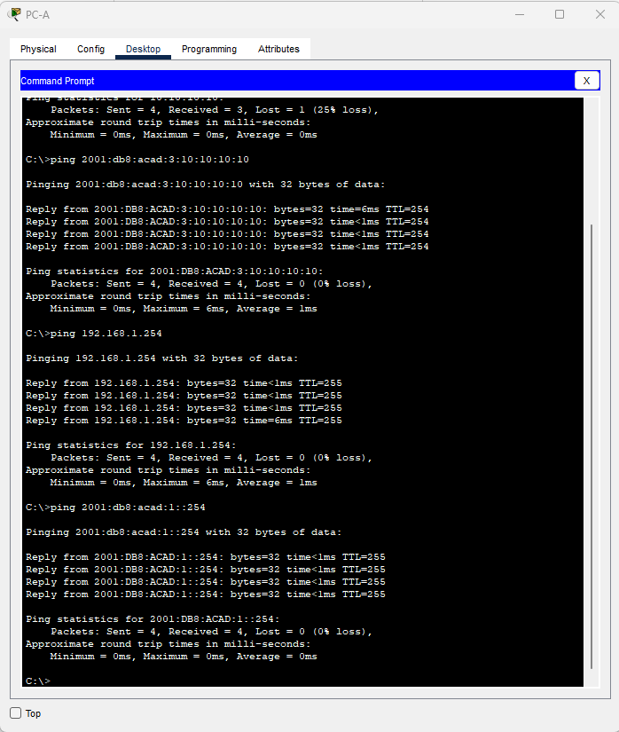

Slide 5
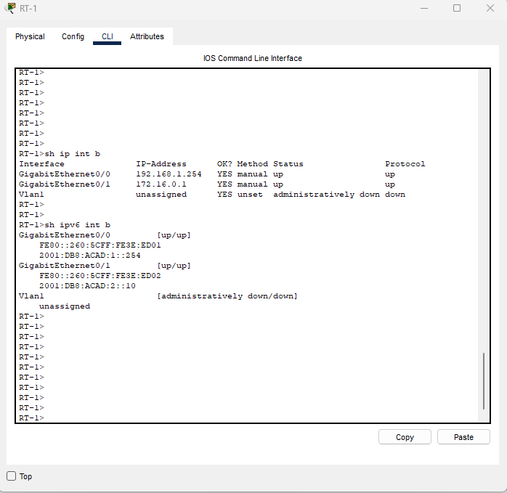

Slide 6
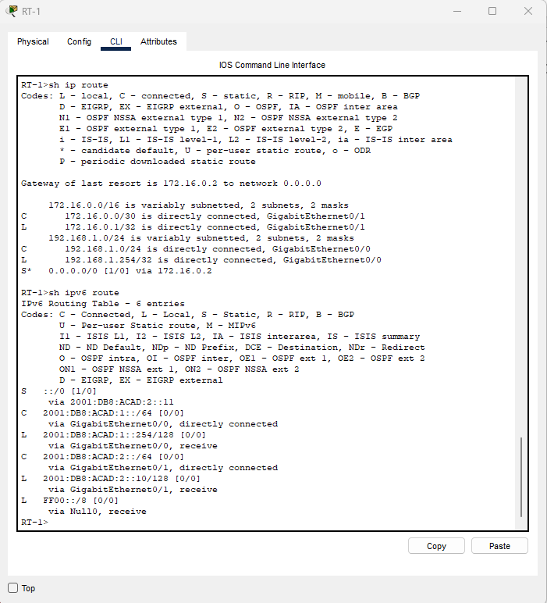

Slide 7
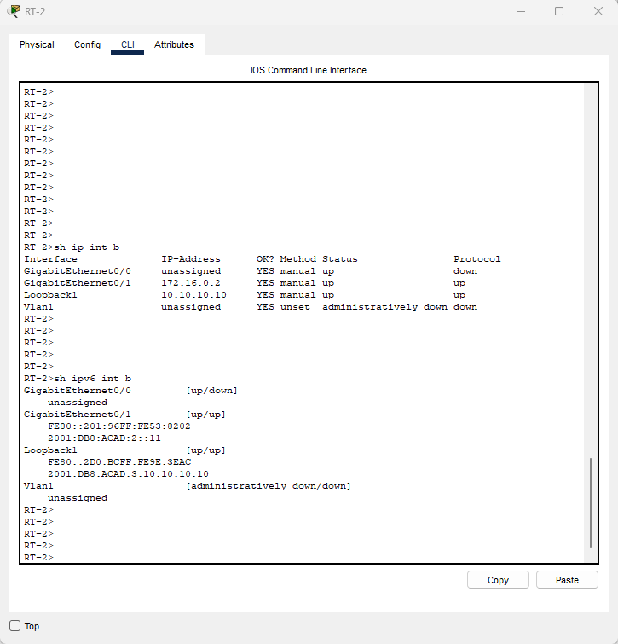

Slide 8
